Slide 1
Non Regular Languages
Automata Theory
Ege University
Department of Computer Engineering
Yrd. Doç. Dr. R. Cenk Erdur, 2012

Slide 2
Definition
Up to now, we have discussed languages that have words in specific forms such as language of words that begin and end with a, language of words that do not contain bb, so on…
Are there languages that are in different (or complex) forms?
  Palindrome ?
  Prime: a^{p} (where p is a prime number) ?
Yrd. Doç. Dr. R. Cenk Erdur, 2012

Slide 3
Definition
Can you write a regular expression for Palindrome or Prime?
We need advanced models to recognize these languages.
  For example, some of these languages are recognized by “Push Down Automata” models.
Yrd. Doç. Dr. R. Cenk Erdur, 2012

Slide 4
Definition
A language that cannot be defined by a regular expression is called a nonregular language.
By Kleene’s theorem, a nonregular language can also not be accepted by any F.A. or T.G.
Yrd. Doç. Dr. R. Cenk Erdur, 2012

Slide 5
Loops in the F.A. Models
L={Null, ab, aabb, aaabbb, aaaabbbb, ...}
or L = a^{n}b^{n}
Can you write a R.E. for L?
Does the R.E: a*b* defines L ???
a*b* ≠ a^{n}b^{n}
a^{n}b^{n} does not include aaab, abb, …
Yrd. Doç. Dr. R. Cenk Erdur, 2012

Slide 6
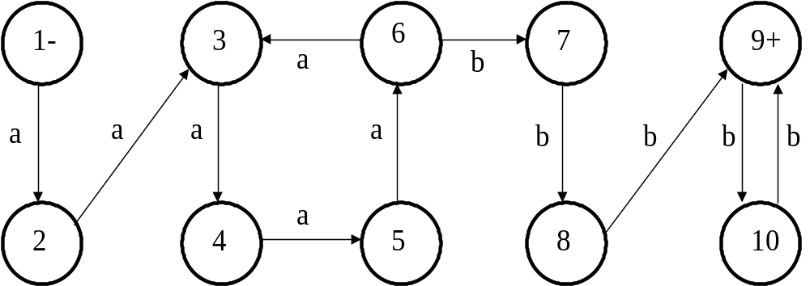
Loops in the F.A. Models
Can you build a F.A. for L=a^{n}b^{n} ?
a⁵b⁵, a⁹b⁹ are accepted. But, what about a¹³b⁹ ?.
Yrd. Doç. Dr. R. Cenk Erdur, 2012

Slide 7
Loops in the F.A. Models
The F.A. in the previous slide includes two loops, which are in states 3-4-5-6 and 9-10. Thus, it does not accept L=a^{n}b^{n}.
Yrd. Doç. Dr. R. Cenk Erdur, 2012

Slide 8
“Pumping Lemma”
Let L be any regular language that has infinitely many words. Then there exist some three strings x, y, z (where y is not the null string) such that strings of the form xy^{n}z (for n=1,2,3,.....) are words in L.
Yrd. Doç. Dr. R. Cenk Erdur, 2012

Slide 9
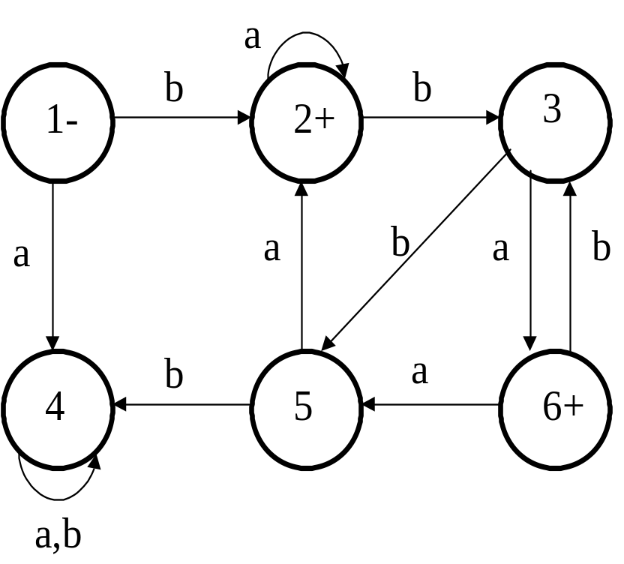
Pumping Lemma
w=bbbababa
x=b
y=bba
z=baba
b bba bba baba ∈L .
b bba bba bba baba ∈L.
In general;
x y^{n} z ∈L.
Yrd. Doç. Dr. R. Cenk Erdur, 2012

Slide 10
Extended Version of Pumping Lemma
Let L be an infinite language accepted by a finite automation with N states. Then, for all words w in L that have more than N letters, there are strings x, y, and z, where y is not null and length(x)+length(y) does not exceed N such that w=xyz and all strings of the form xy^{n}z (for n=1, 2, 3, …) are in L.
Yrd. Doç. Dr. R. Cenk Erdur, 2012

Slide 11
Extended Version of Pumping Lemma
Example: Prove that Palindrome is a nonregular language.
Solution: Assume that N=77 (There are 77 states.) Also assume that w=xyz=a⁸⁰ba⁸⁰. Please note that |w|=161 and 161 > 77.
Break into three parts provided that |x+y| < 77:
a⁷⁵ a a⁴ba^{80 =>} x=a⁷⁵, y=a, z=a⁴ba⁸⁰
x y^{n} z = a⁷⁵ aa...a a⁴ba⁸⁰ must be an element of Palindrome .
But, a^{moreThan80}ba⁸⁰ ∉ Palindrome. Thus, Palindrome is a
nonregular language.
Yrd. Doç. Dr. R. Cenk Erdur, 2012

Slide 12
Extended Version of Pumping Lemma
Questions: Are the languages given below regular or nonregular? Prove your answer.
  L=a^{n*n} (Square language).
a, aaaa, aaaaaaaaa, .......
  L=a^{n}b^{2n} abb, aabbbb, aaabbbbbb, ......
Yrd. Doç. Dr. R. Cenk Erdur, 2012

